Slide 1

Advanced Pandas

Slide 2
Advanced Pandas
Use string methods to create and manipulate columns
Map to quickly create indicators from categorical variables
Apply to create new columns that are complex functions of other columns.
Iterating through the rows of a dataframe

Slide 3
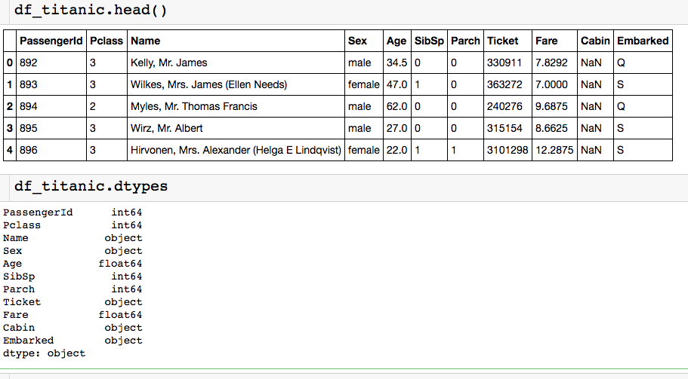
Titanic Data Set
Passenger data from people onboard the Titanic:

Slide 4
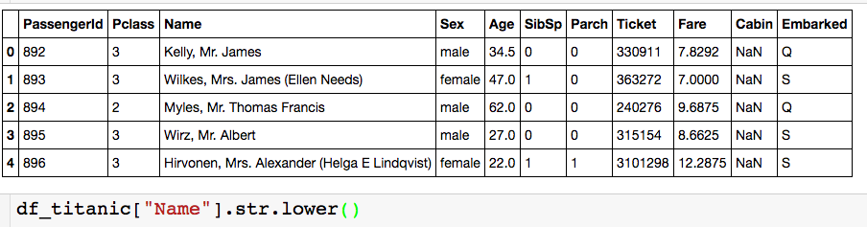
Using String Methods
After column name you need .str if you wan to use a string method

Slide 5
Using String Methods
.“string_method”
After column name you need .str if you wan to use a string method

Slide 6
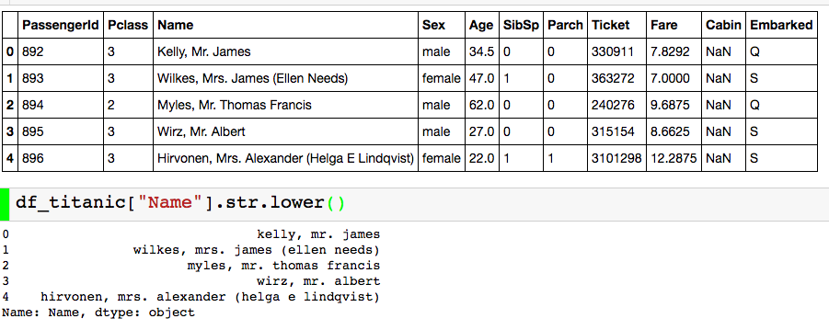
Using String Methods
Returns series with all lower case in the name column.

Slide 7
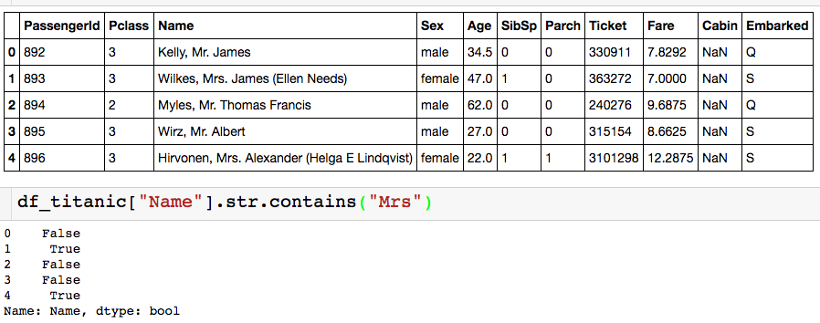
Using String Methods
Let’s say I wanted to know the proportion of “Mrs.” in the data set

Slide 8
Using String Methods
Let’s say I wanted to know the proportion of “Mrs.” in the data set
Returns boolean series with True if name contains “Mrs.” and False otherwise.

Slide 9
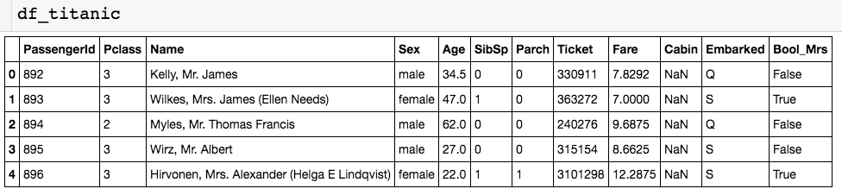
Using String Methods
Let’s say I wanted to know the proportion of “Mrs.” in the data set
Create new column column called “Bool_Mrs” that stores these booleans:
New column

Slide 10

Using String Methods
Let’s say I wanted to know the proportion of “Mrs.” in the data set
Create new column column called “Bool_Mrs” that stores these booleans:

Slide 11
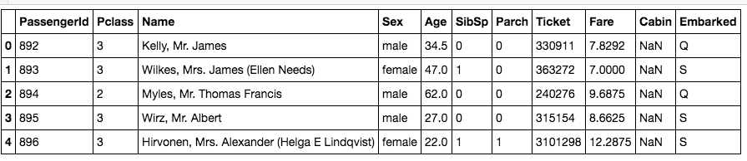
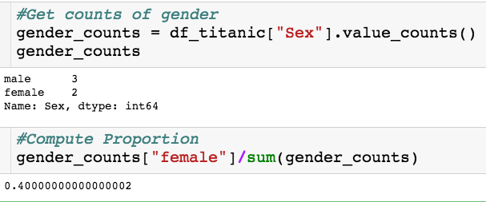
Using Map
Let’s say I wanted to know the proportion of females on the ship.
We already know how to do this:

Slide 12
Using Map
We already know how to do this:
Downside of this approach:
Will not be useful for any sort of estimation approach where we use Sex as a categorical variables
Generally more involved

Slide 13
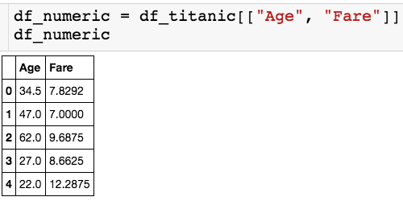
Using Apply
Let’s only pick out a couple of the numerical columns.
The apply() method lets us use custom or built in functions to multiple columns.
Let’s begin by applying built in functions…

Slide 14

Using Apply
Let’s only pick out a couple of the numerical columns.
Name of function
Axis = 0 - apply column wise
Axis = 1 - apply row wise

Slide 15

Using Apply
Let’s only pick out a couple of the numerical columns.
Returns series where the index is the column name.

Slide 16
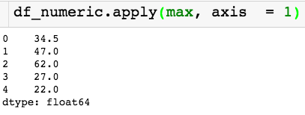
Using Apply
Let’s only pick out a couple of the numerical columns.
Changed axis!
Returns series where the index is the index of the dataframe.

Slide 17
Using Apply
Let’s only pick out a couple of the numerical columns.
Changed axis!
Returns series where the index is the index of the dataframe.

Slide 18

Using Apply
Let’s only pick out a couple of the numerical columns.
Applying numpy ceiling function to the column fare

Slide 19
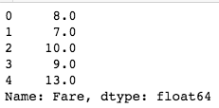
Using Apply
Let’s only pick out a couple of the numerical columns.
We can use apply to create new columns!

Slide 20
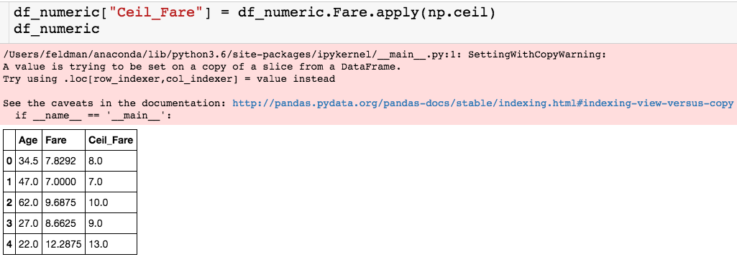
Using Apply
Let’s only pick out a couple of the numerical columns.
Pesky SettingWithCopyWarning
New column

Slide 21
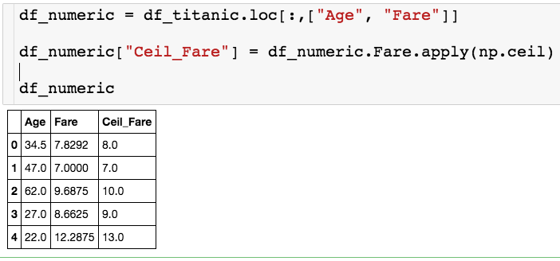
SettingWithCopyWarning
Two ways to avoid this warning:
Define df_numeric by slicing with .loc

Slide 22
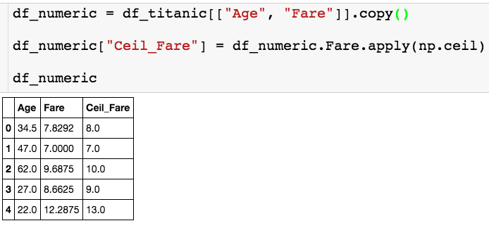
SettingWithCopyWarning
Two ways to avoid this warning:
or set df_numeric equal to a copy of the slice of the dataframe

Slide 23
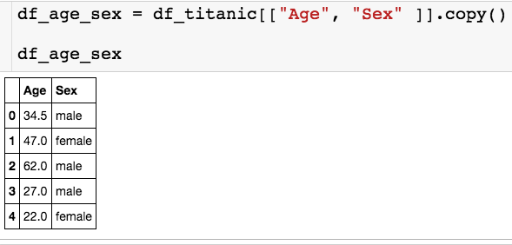
Using Apply
Let’s see how we can use apply with a custom function on a single column:
Let’s use apply to create a binary column that is 1 if the passenger is male and 0 if female.

Slide 24
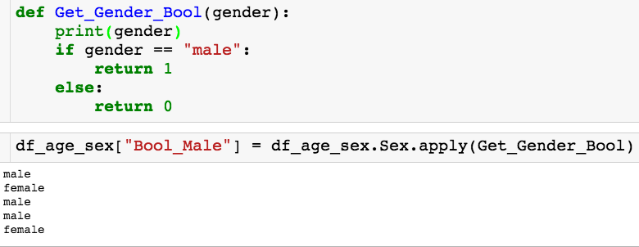
Using Apply
Let’s see how we can use apply with a custom function on a single column:

Slide 25
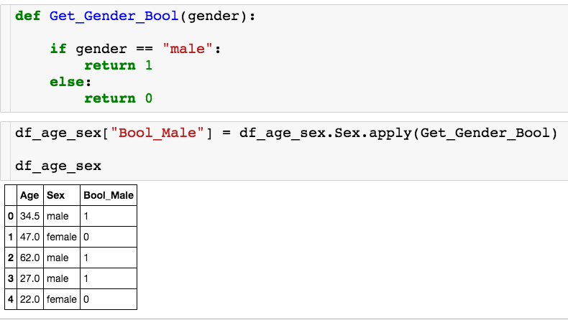
Using Apply
Let’s see how we can use apply with a custom function on a single column:
Calls Get_Gender_Bool once for each row.

Slide 26
Using Apply
Let’s see how we can use apply with a custom function on a single column:
Let’s use apply to create a binary column that is the passenger is above 60 years old and 0 otherwise.

Slide 27
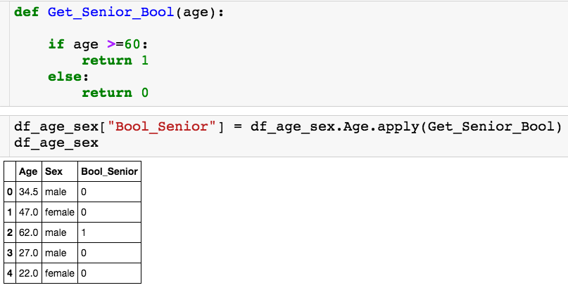
Using Apply
Let’s see how we can use apply with a custom function on a single column:
I’ll apply my custom function on the age column.

Slide 28
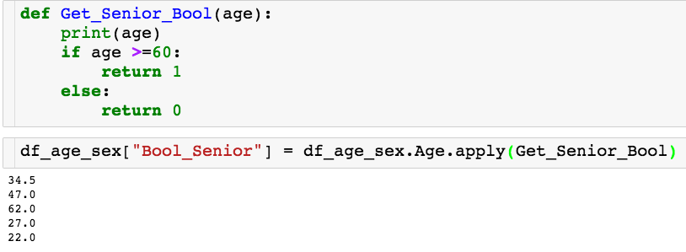
Using Apply
Let’s see how we can use apply with a custom function on a single column:

Slide 29
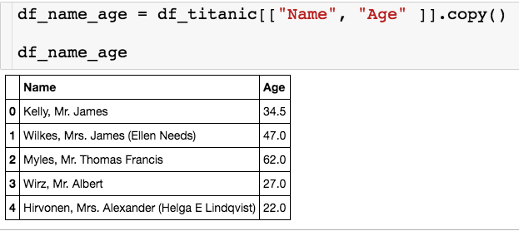
Using Apply
Last one:
Let’s use apply to a new column called Title that’s stores each passenger’s title (Mr./Mrs.)

Slide 30
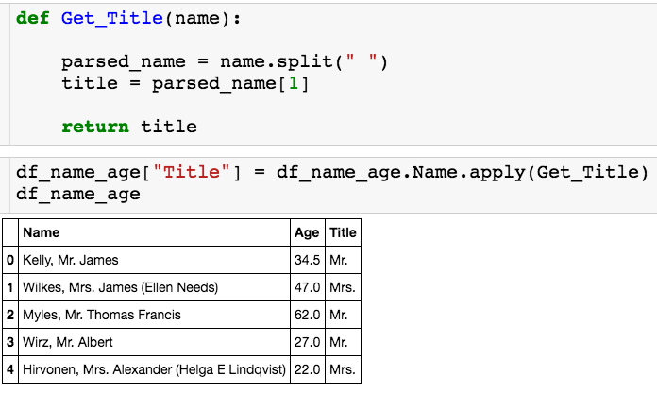
Using Apply
Last one:

Slide 31
Using Apply
Let’s see how we can use apply with a custom function on a data frame:
Let’s use apply to create a binary column is 1 if the passenger is male and over 60 and 0 otherwise.

Slide 32
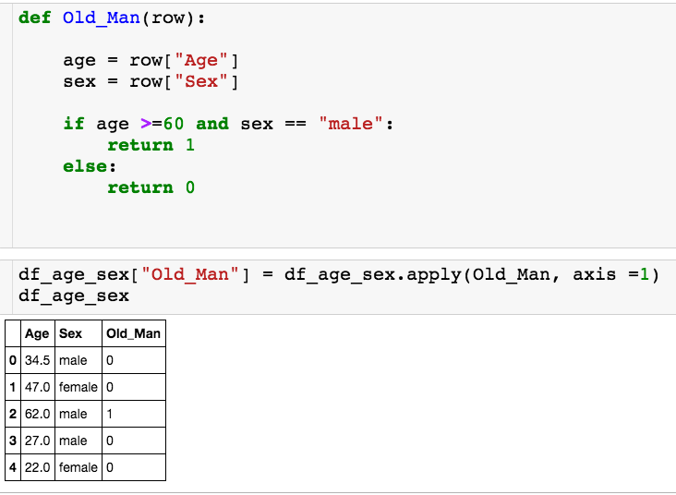
Using Apply
Let’s see how we can use apply with a custom function on a data frame:
Apply to entire dataframe
Apply to rows

Slide 33
Using Apply
Let’s see how we can use apply with a custom function on a data frame:
Each row gets passed as a series to the function, where the column names are the index.

Slide 34
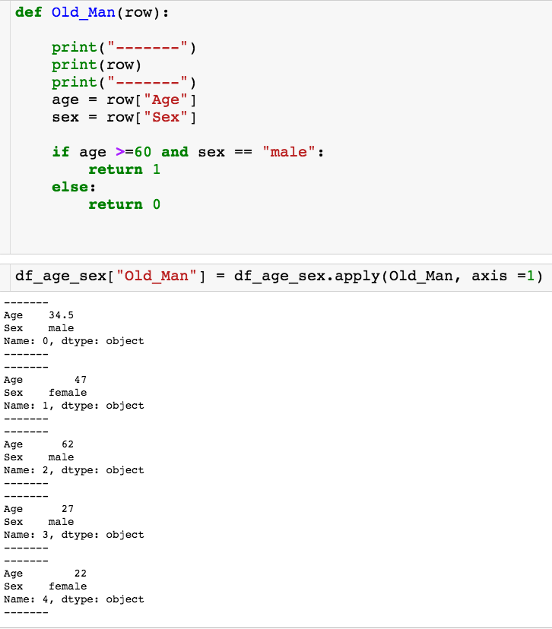
Using Apply
Let’s see how we can use apply with a custom function on a data frame:
The function Old_Man gets called for each row in the dataframe.

Slide 35
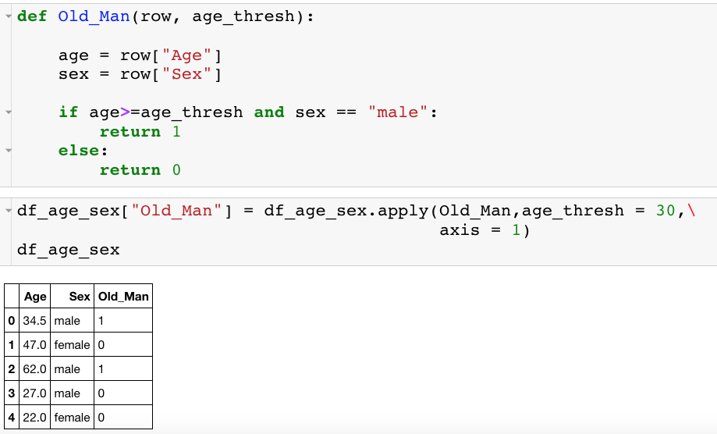
Using Apply – Extra Input
Let’s see how we can use apply with a custom function that takes another input on a data frame:

Slide 36
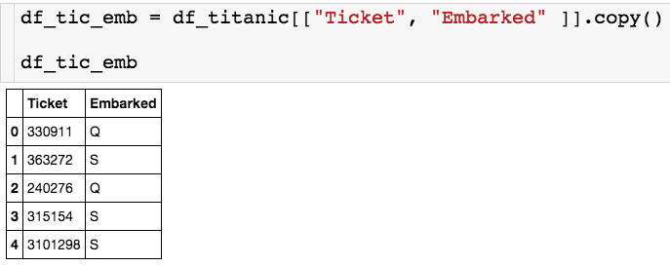
Using Apply
One more example:
I want to create a new column is embarked plus the first number of the ticket. So, in the first row, this new column should read “Q3”

Slide 37
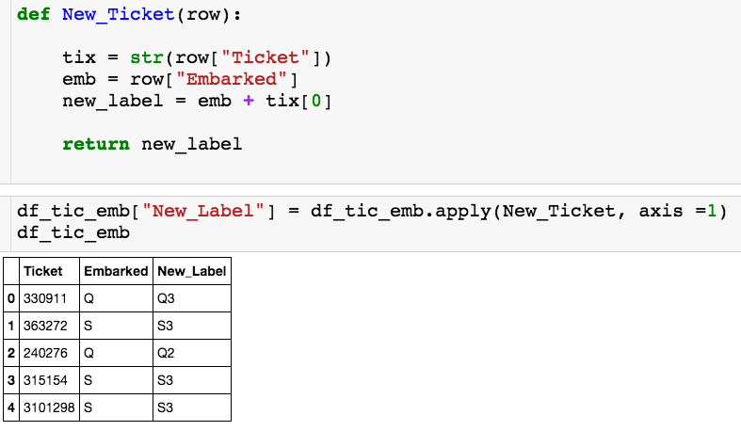
Using Apply
One more example:

Slide 38
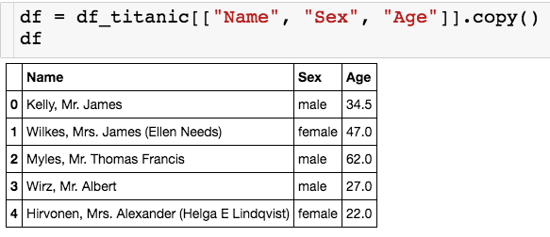
Iterrows
You can use the iterrows() method to go through the rows of a dataframe using a for loop.

Slide 39
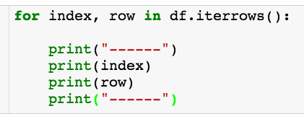
Iterrows
Returns two loop variables
Index of df
Row as series

Slide 40
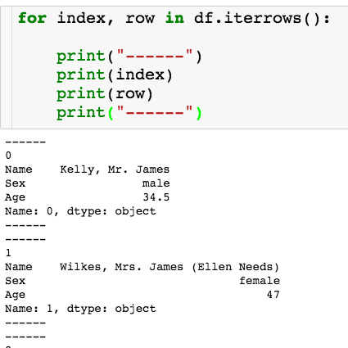
Iterrows

Slide 41
Iterrows
Let’s say I want to create a dictionary where I have an entry for each passenger where the key is the last name and the value is the age.

Slide 42
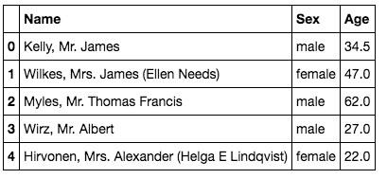
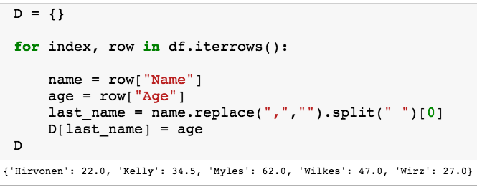
Iterrows

